Slide 1

Data mining for stock prediction
Wqd7005 Data mining project

Slide 2
Course lecturer & Team members
Lecturer:
Assoc. Prof. Dr. Teh Ying Wah (SCOPUS link)
Project Members:
Lim Shien Long (WQD180027)
Vee Kin (WQD180064)
Vikas Mann (WQD180051)
Yong Keh Soon (WQD180065)

Slide 3

Data mining steps
Step1: Data Selection
Step2: Data Preprocessing
Step3: Data Transformation
Step4: Interpretation
Step6: Conclusion
Step5: Insights

Slide 4
Step1: selection
Daily stock data (ie: Open, Close, Volume, Bid/Ask, P/E, Market Cap)
Daily indices data (ie: KLSE, Dow Jones, NASDAQ, HANG SENG)
Business news (ie: The Edge, Star Business, Malaysiakini)
Social media (ie: Twitter)

Slide 5
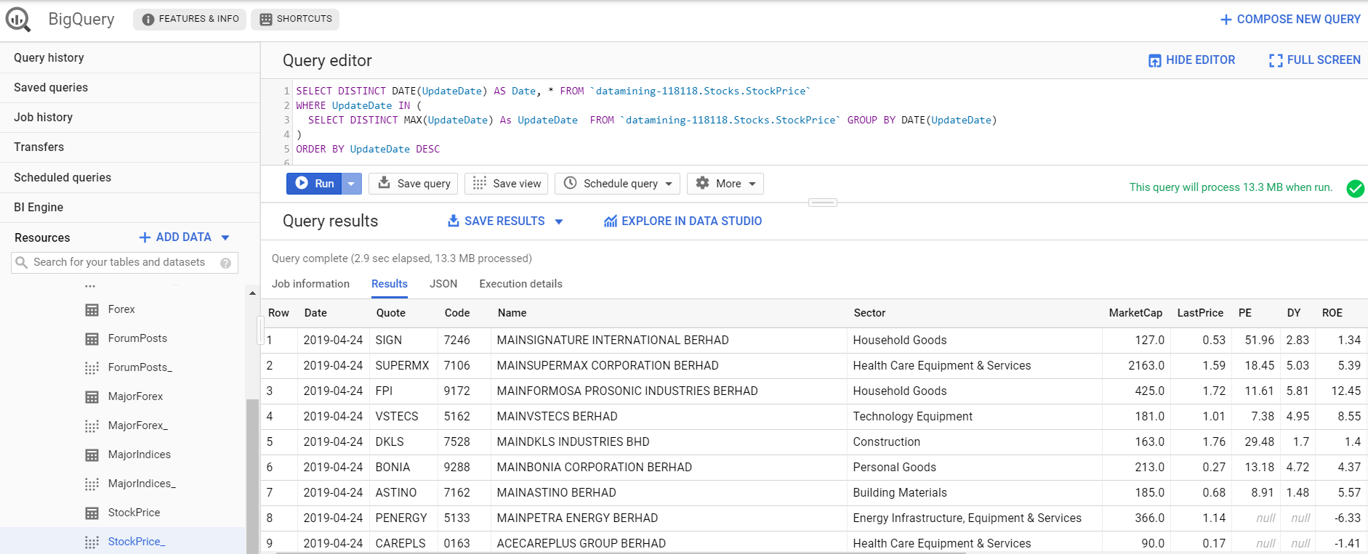






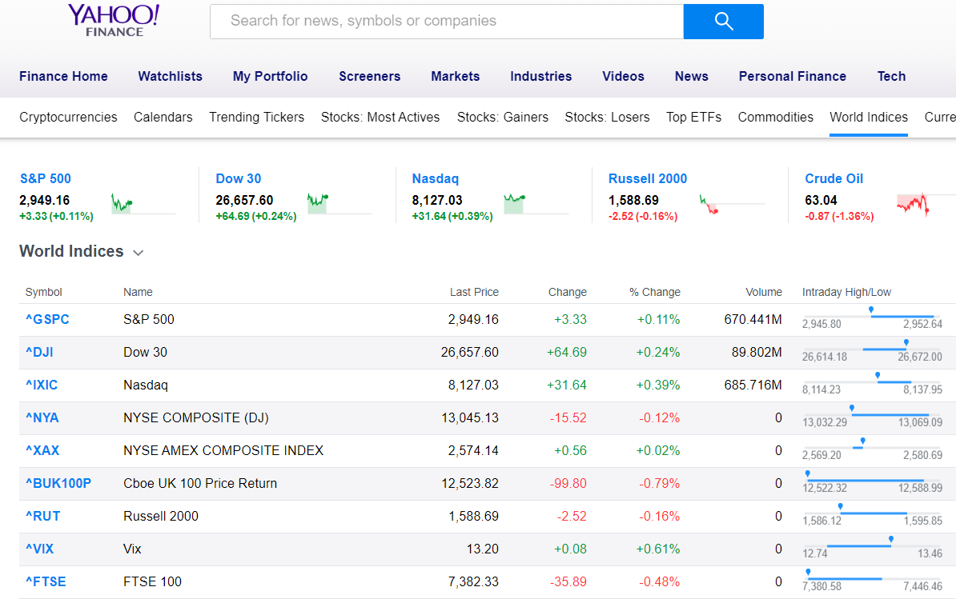
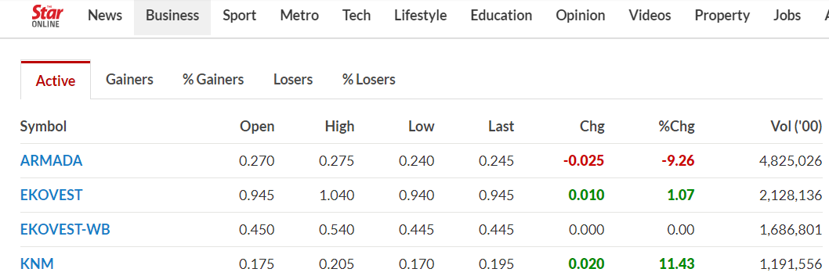
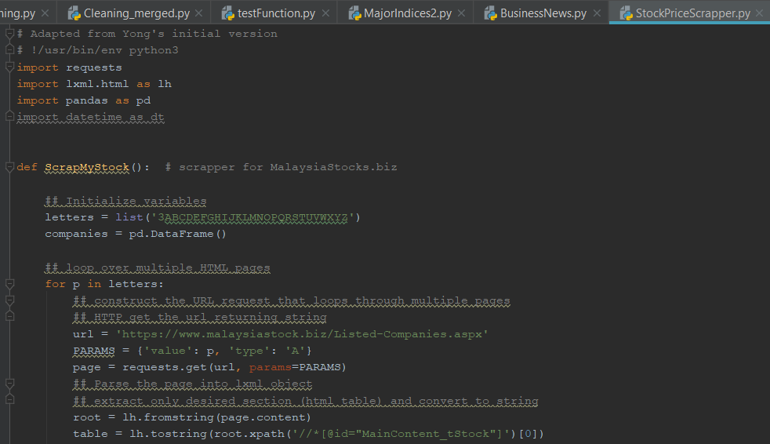

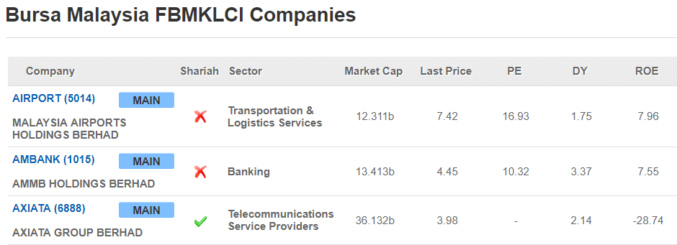
Daily Stock Data
Daily Indices
Biz News
Upload to serverless Data Warehouse (GBQ)
Social Media
Webcrawl with Python

Slide 6
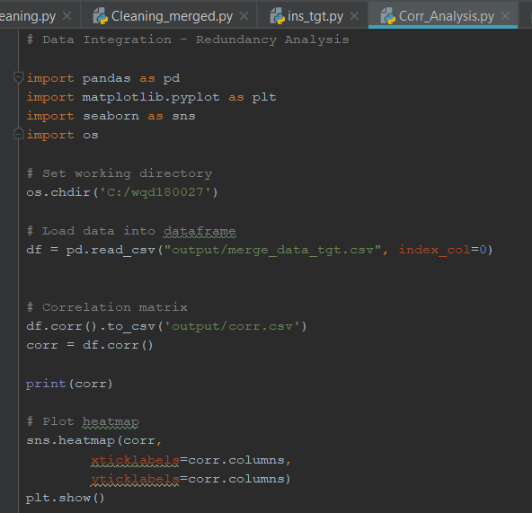
Step 2: Data preprocessing
Taking a look at crawled data.
Missing values observed in Indices, Currency and Commodities data.
Treatment for missing values.
Missing values imputed by replacing with the mean.
Correlation heatmap
Attributes that are correlated are removed.
NASDAQ and S&P500 very high correlation.
NASDAQ removed.
CrudeOil and BrentCrude very high correlation.
CrudeOil removed.

Slide 7
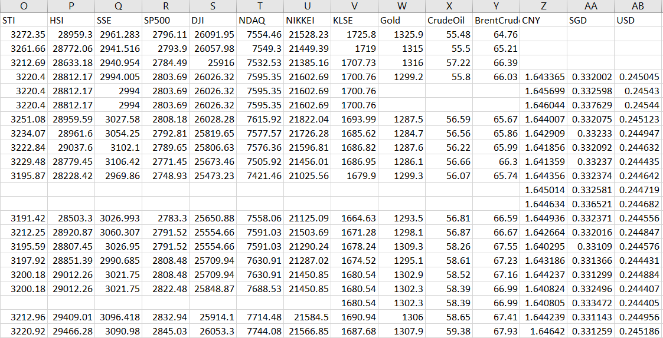
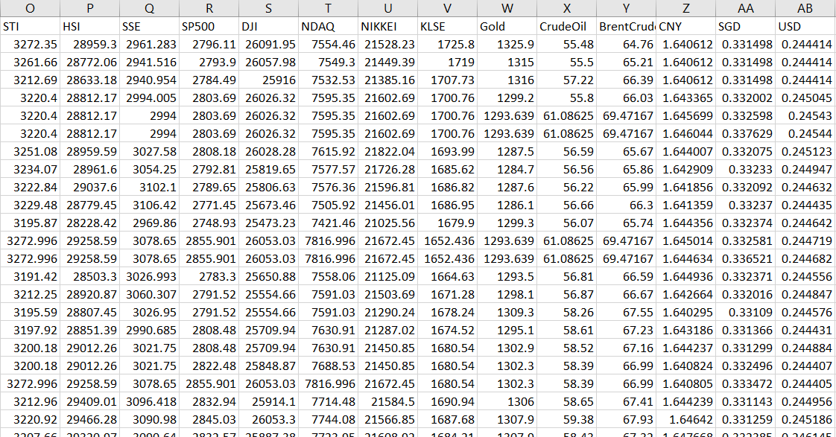
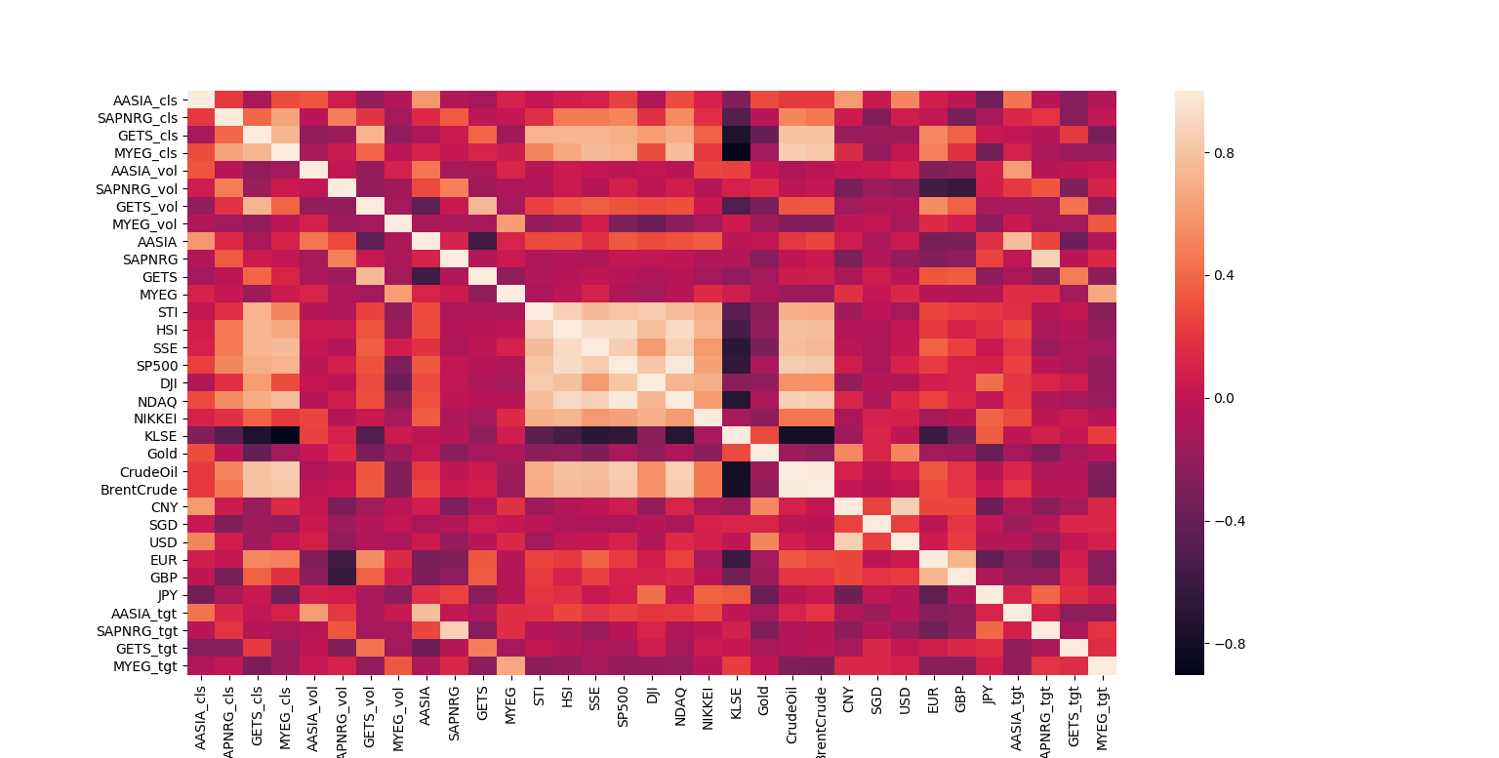
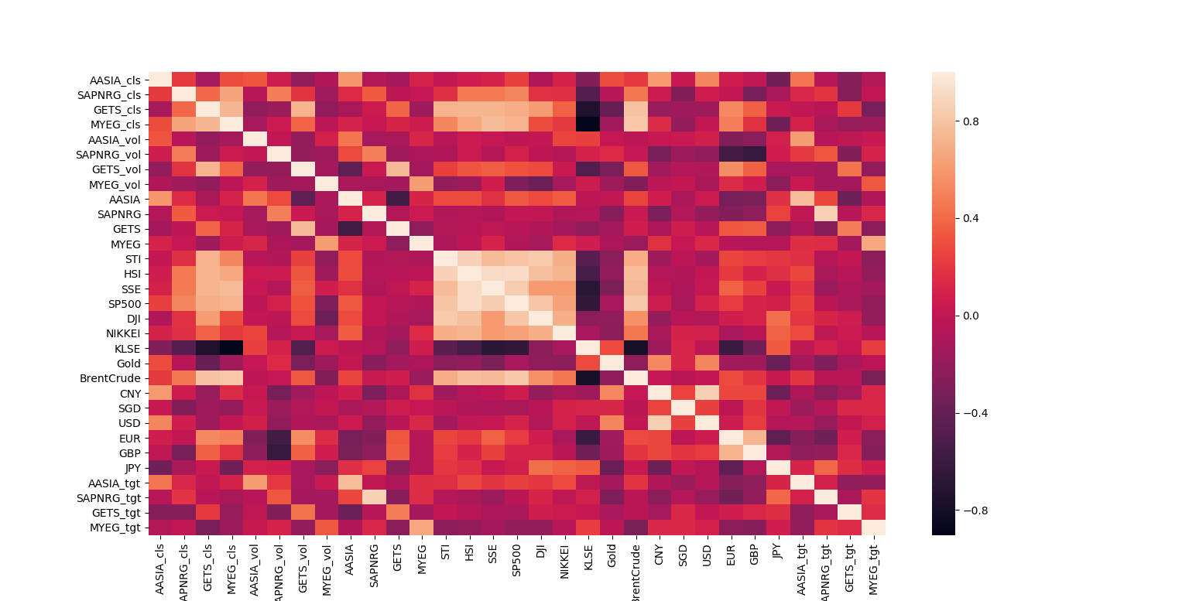
Missing Values
Missing Values
Impute with
Mean
Missing Values
Missing Values
Drop correlated attributes

Slide 8
Step 3: Data transformation
Stock, Indices, Commodities, Forex and Business News data require transformation in order to be merged.
Stock, Indices, Commodities and Forex data was pivoted using Date as index.
Business News data transformed using aggregation.
Business News data identified by stock code.
Stock dataset identify by stock quote. Therefore a python code to match the code to a lookup table was created to add a ‘quote’ attribute to Business News data.
‘stock_code.py’
All datasets are then merged.

Slide 9
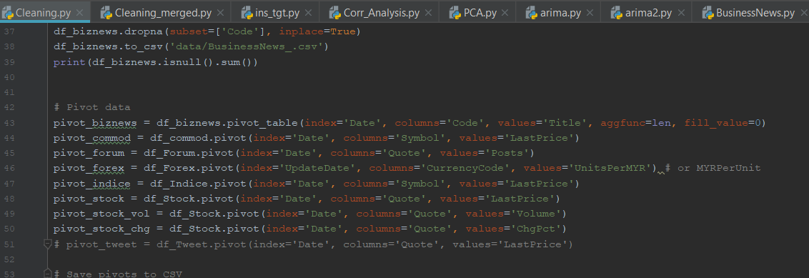
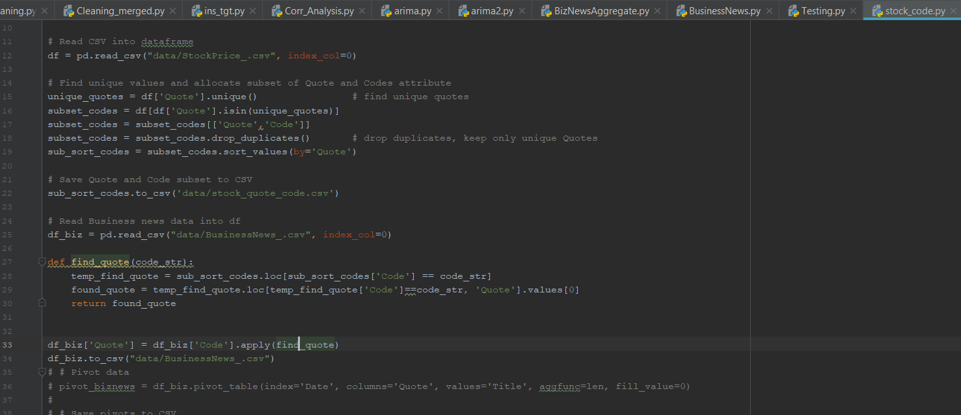
Pivoting
Find ‘Quote’ corresponding to ‘Code’

Slide 10
Step 4: Interpretation
Add target column
Categorical: Up (1) or not up (0)
If percent change of stock is < or = to 0,
Not up (0)
Else (when stock > 0)
Up (1)
Visualization of data
Quantitative and Qualitative Analysis

Slide 11
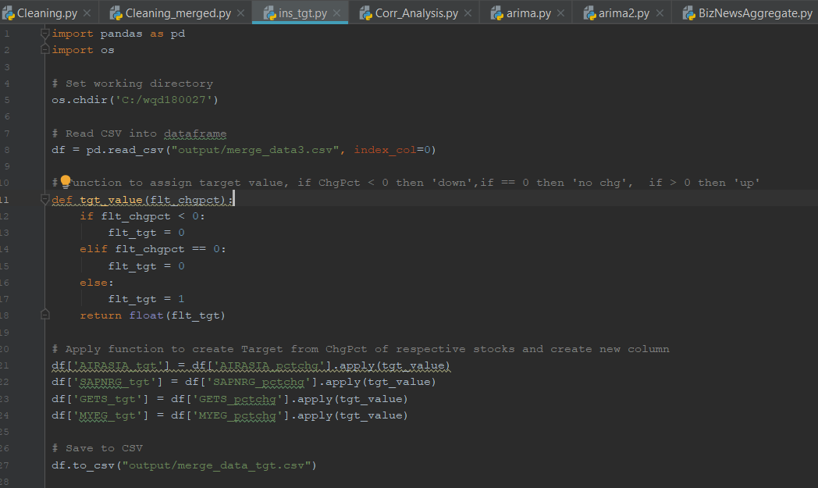
Insert target:

Slide 12
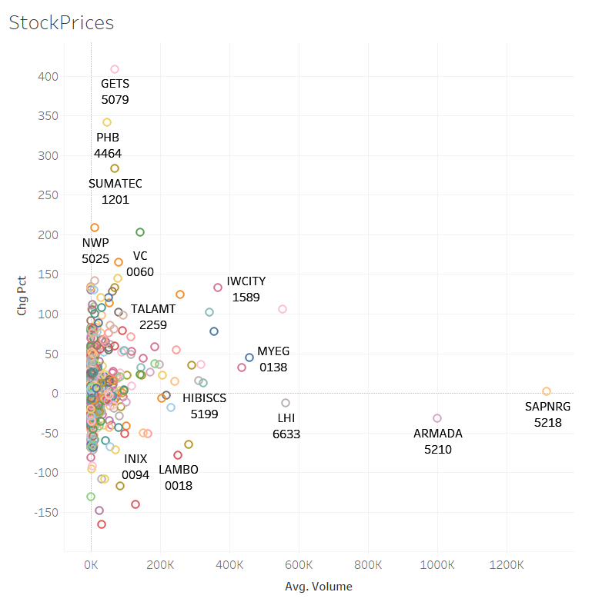
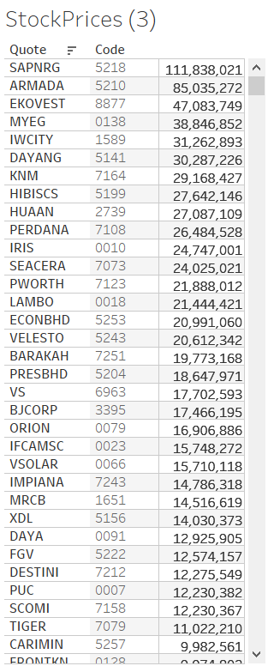
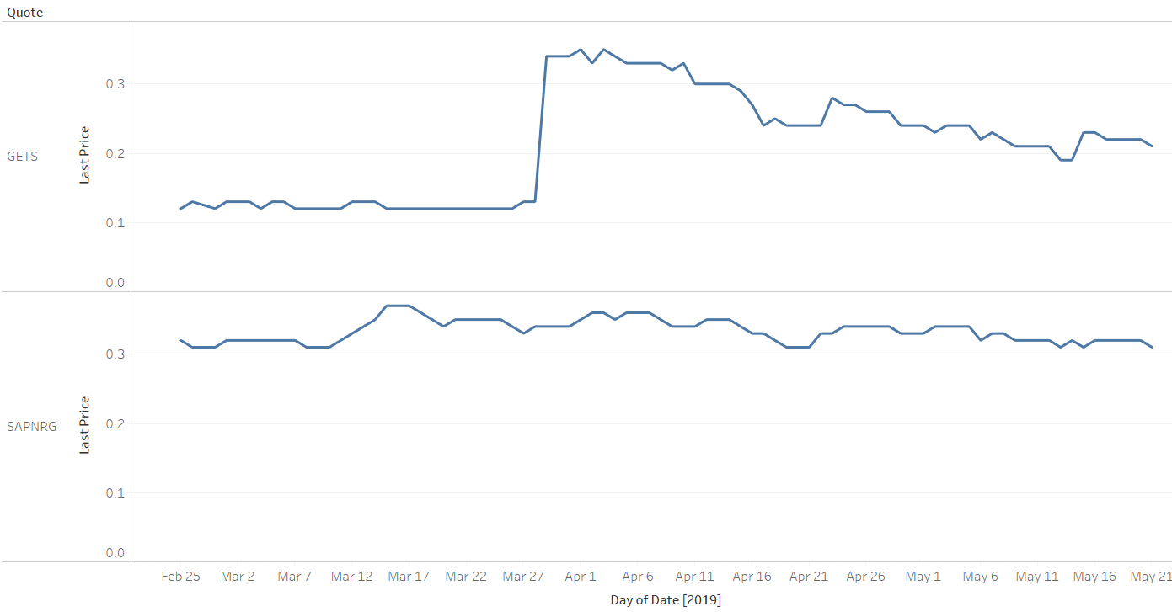
Stock Prices Visualization
SAPNRG (5218) observed to have highest trade volume at 111 million.
However it has low price changes (Chg Pct) close to 0.
GETS (5079) on the other hand have much lower volume but with high Chg Pct.
This effect can be seen on the right. GETS observed to have big changes in last price.

Slide 13
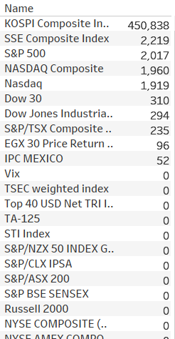
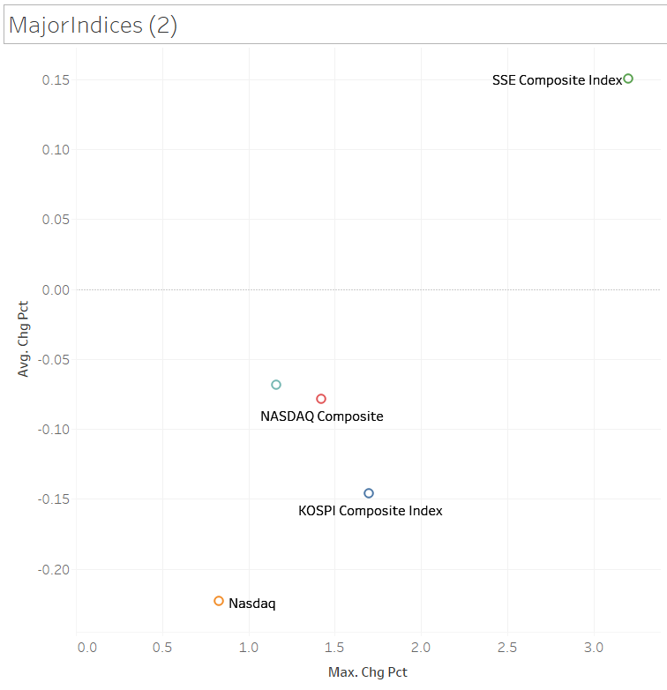
Indices Visualization
KOSPI has extremely high volume.
Top 5 Indices by Volume:
KOSPI (Korea)
SSE (Shanghai)
S&P500 (US)
NASDAQ (US)
DOW30 (US)
SSE has high average changes to index value.

Slide 14
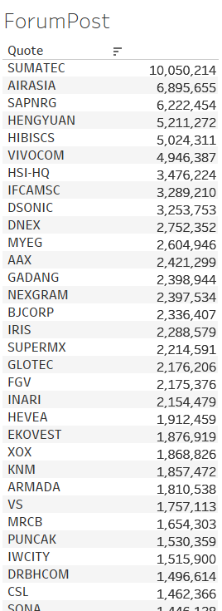
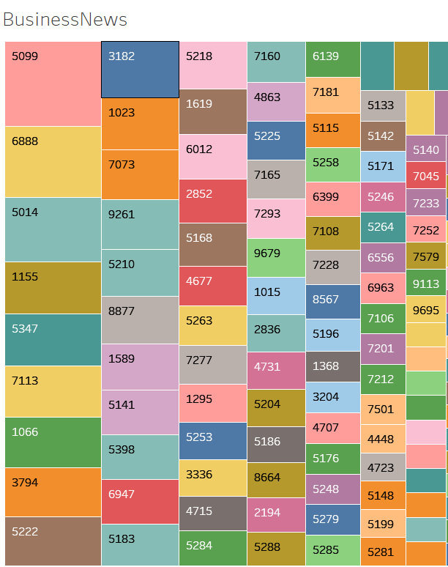
Business News Visualization
Tree map visualization shows stock code 5099 with highest news count.
Top 5 counts:
5099, Airasia
6888, Axiata
5014, Malaysia Airport
1155, Maybank
5347, TNB
Forum Post Visualization
Top 5 counts:
Sumatec
Airasia
Sapnrg
Hengyuan
Hibiscus

Slide 15
Step 5: insights
Airasia stock percent change used as categorical target for decision tree.
Airasia stock closing price used as interval target for SAS Enterprise Miner Time Series Forecasting (Time Series Exponential Smoothing)

Slide 16
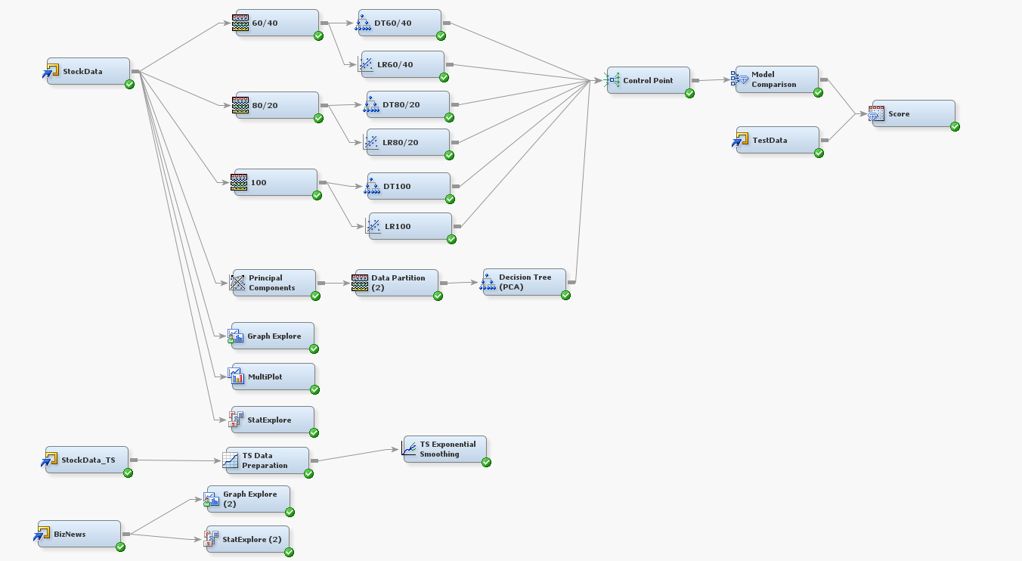
SAS Enterprise Miner Diagram

Slide 17
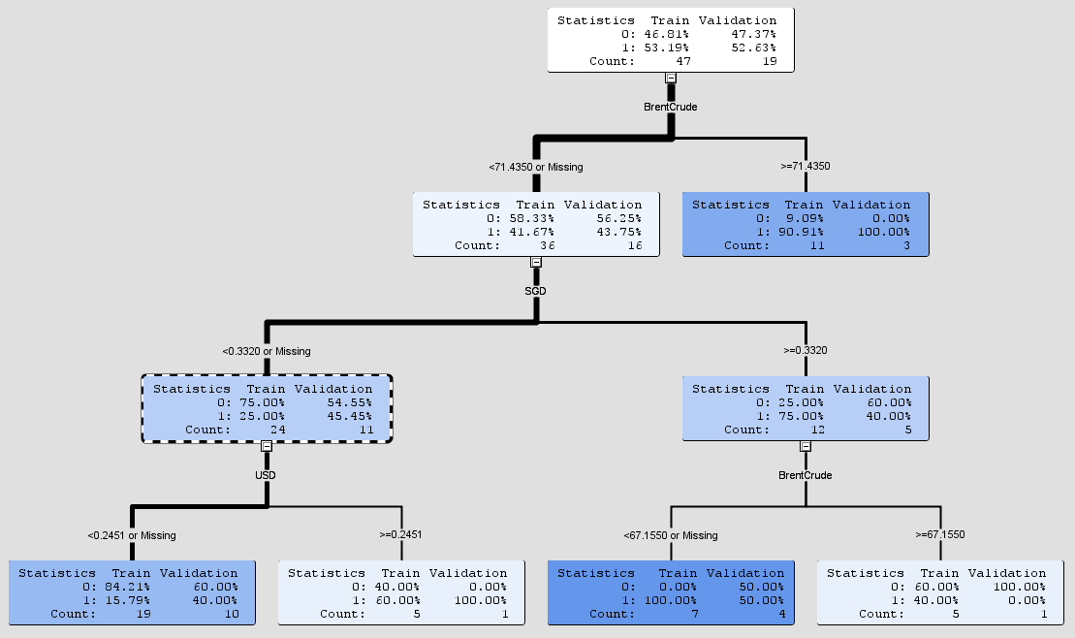
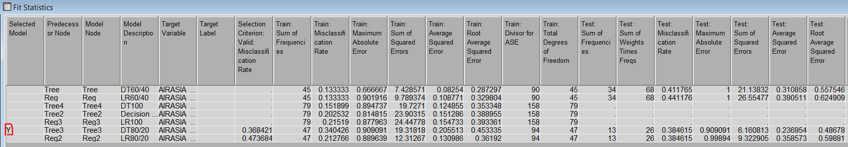
Decision Tree
Decision Tree with 80/20 split had lowest error.
Decision tree shows for deciding if Airasia target is up (1) or not-up (0), can be split by Brent Crude oil price.

Slide 18
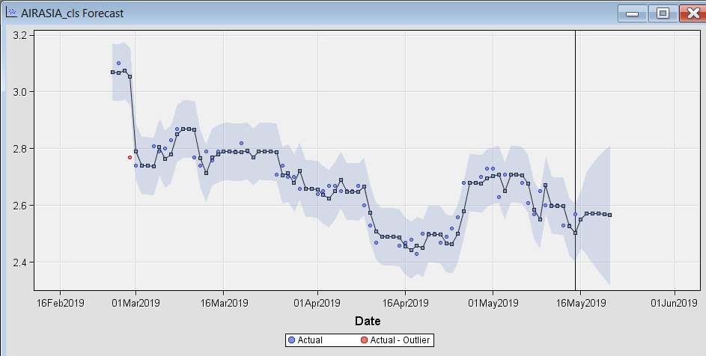
SAS Enterprise Miner Time Series Forecasting (TS Exponential Smoothing)
Time series exponential smoothing in SAS EM used to predict next price.
Training data until 15 May.
Blue round dots – actual values
Blue square dots connected with line – smoothed (fitted) values
Blue band – confidence intervals for each fitted value

Slide 19
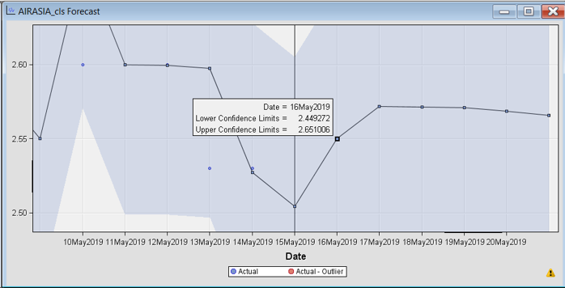
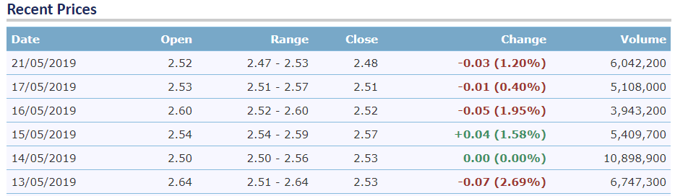
SAS Enterprise Miner Time Series Forecasting (TS Exponential Smoothing) – Airasia Stock
Zooming into forecasted days after 15 May.
Model forecast 16 May:
Forecasted price – 2.55
Lower limit – 2.45
Higher limit – 2.65
Decrease from 15 May (2.57) by 0.02.
Drop 0.7%
Error = Abs(2.52 – 2.55)/Abs(2.52) = 1.2% error
Actual results 16 May:
Close price – 2.52
Decrease from 15 May (2.57) by 0.05.
Actual Drop 1.9%

Slide 20
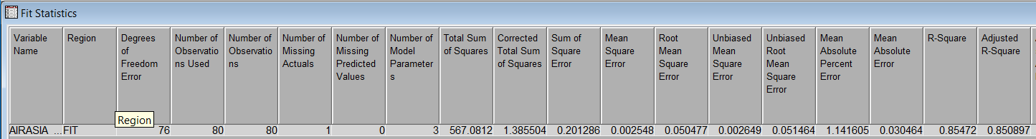
Step 6: Conclusion
SAS EM Model predicted next day (16 May) with 1.2% error.
The model R-squared is 0.85.
RMSE is 0.05.

Slide 21
Backup slides

Slide 22
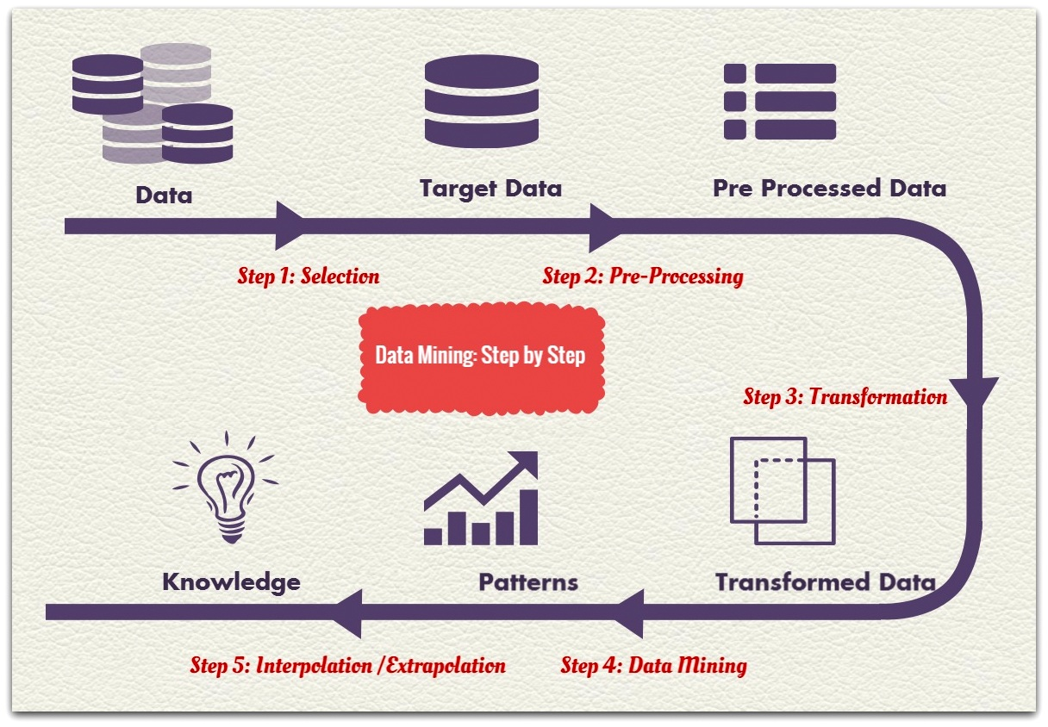
Data mining steps
Source - http://www.sliceofbi.com/

Slide 23
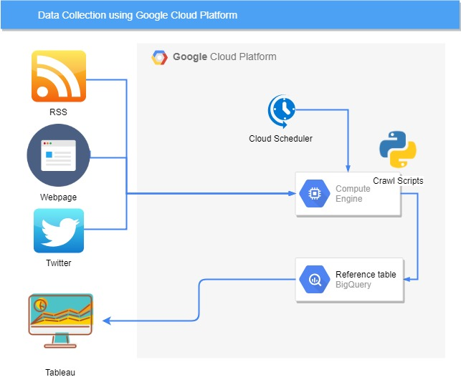
Data Warehouse using Google Cloud Platform
Automated crawling by embedding Google Big Query JSON into Python crawl scripts.
Python crawl scripts executed by Google Compute Engine and is automated using Cloud Scheduler to ‘wake up’ the engine.
Crawled data is uploaded to Google Big Query.

Slide 24
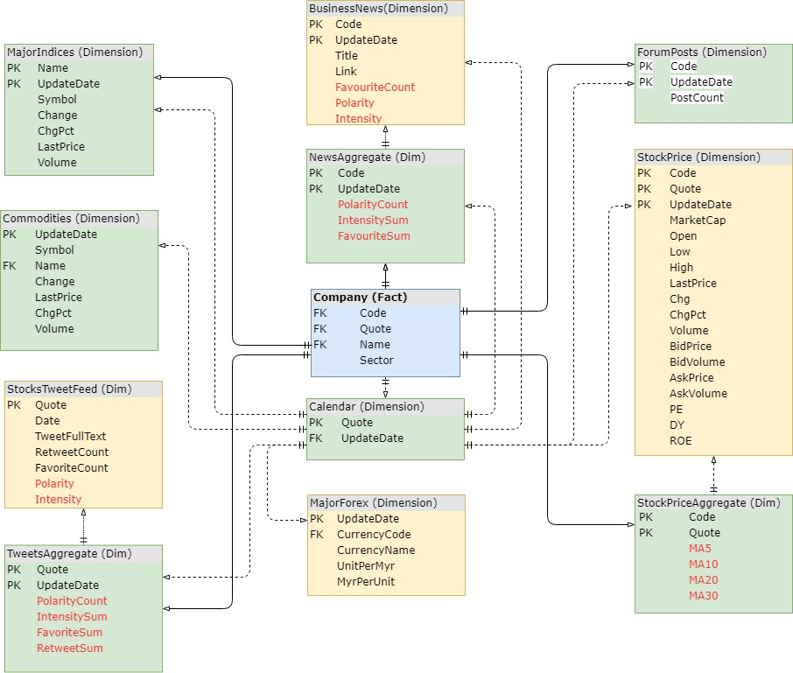
Schema
Sample of schema implemented is shown.
Using Snowflake schema.
Key attribute is UpdateDate

Slide 25
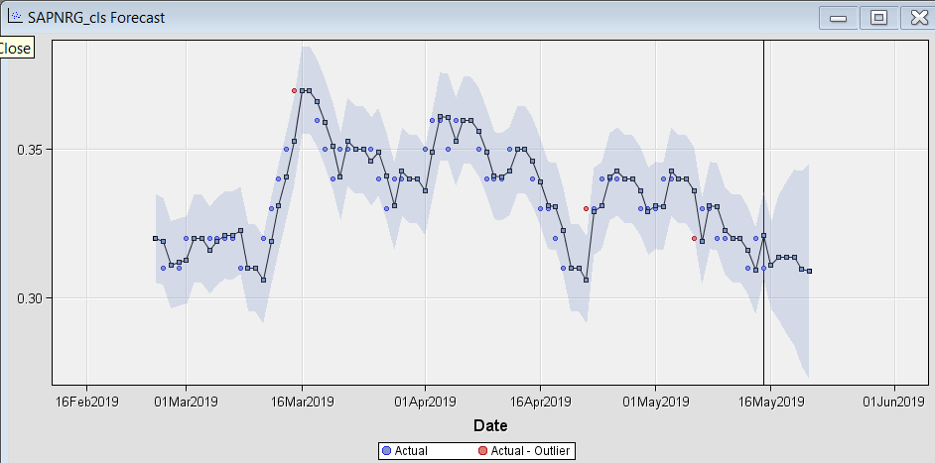

Slide 26
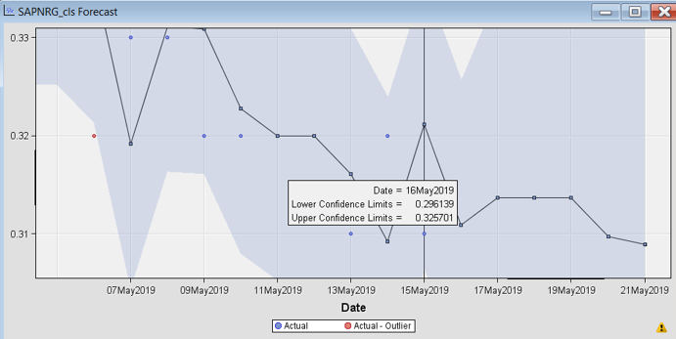
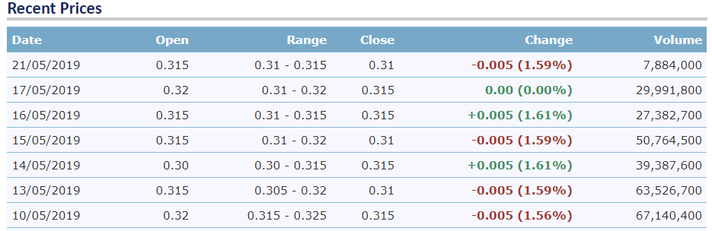
SAPNRG Stock
Zooming into forecasted days after 15 May.
Model forecast 16 May:
Forecasted price – 0.311
Lower limit – 0.296
Higher limit – 0.326
Increase from 15 May (0.31) by 0.001.
Up by 0.3%
Error = Abs(0.310 – 0.311)/Abs(0.310) = 0.3% error
Actual results 16 May:
Close price – 0.315
Increase from 15 May (0.310) by 0.005.
Actual Up by 1.6%

Slide 27

Thank You

